Slide 1



Communicate positively, present yourself credibly, influence strategically and think proactively
Approach note: Ver2.0/ 9th November’16
1

Slide 2
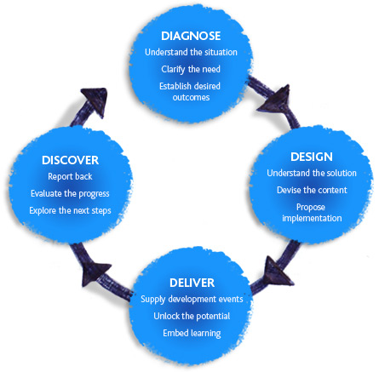
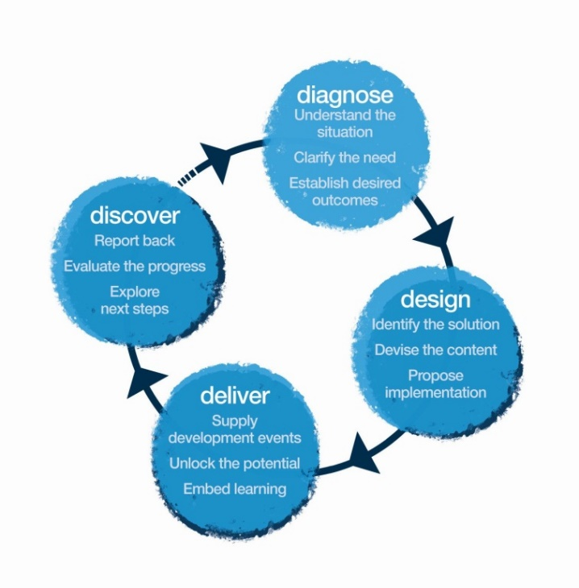
INDEX
Your need as we understand . . . . . . . . . . . . . . . . . . . .3
Our Approach. . . . . . . . . . . . . . . . . . . . . . . . . . . . . . . . 4
Diagnosis . . . . . . . . . . . . . . . . . . . . . . . . . . . . . . . . . . . .5
Design . . . . . . . . . . . . . . . . . . . . . . . . . . . . . . . . . . . . . . . . . . . . . .6
Journey Overview . . . . . . . . . . . . . . . . . . . . . . . . . . . . . . . . . . . . .7
Sample Learning Objectives of the workshop . . . . . . . . . . . . . .8
Sample Workshop Design. . . . . . . . . . . . . . . . . . . . . . . . . . . . 9-12
ProgressIT . . . . . . . . . . . . . . . . . . . . . . . . . . . . . . . . . . . . . . . . .13
One on One Coaching call . . . . . . . . . . . . . . . . . . . . . . . . . . . .14
Implementation day . . . . . . . . . . . . . . . . . . . . . . . . . . . . . . . . .15
Discovery Meeting. . . . . . . . . . . . . . . . . . . . . . . . .16
Ambience. . . . . . . . . . . . . . . . . . . . . . . . . . . 17
Your Investment . . . . . . . . . . . . . . . . . . .18,19
2

Slide 3
Your need as we understand
Situation
There is a team of 6 to 7 AVPs/ VPs in the Global Mobility Services ( GMS) at Genpact. They look at the movement of people across the globe: Immigration, Visa, Tax, HR. The expectations from AVPs/ VPs is to:
Get attached to each business vertical and become a SPOC of that business line.
Being able to present themselves credibly
Being able to influence strategically
Be more polished and know the nuances of approaching instead of having strictly transactional conversations
Opportunity
The AVPs/ VPs are used to transactional work. You would like them to become enabler and create awareness around their new role. Also to start communicating positively.
Implication
The business is suffering as last minute wants lead to complaints. Eg: One of the business promised the client of a delivery within 2 weeks however when the GMS team checked the actual turn around time, it was three weeks. This dropped Genpact’s credibility.
Need
There is a two day solution required for the need mentioned above.
3

Slide 4

Our Approach
Methodology
We use Interactive theatrical exercises along with Psychological and L & D tools
4

Slide 5
Pre Work Findings
6

Slide 6
Research Methodology
There is a team of 6 to 7 AVPs/ VPs in the Global Mobility Services ( GMS) at Genpact. They look at the movement of people across the globe: Immigration, Visa, Tax, HR. The expectations from AVPs/ VPs is to:
To capture the needs and expectations from the two days, we conducted pre work with 3 participants
Sample Size : 3 participants

Slide 7

Our Curiosity : Basis of Inquiry
The Pre work agenda was prepared based on the client’s mandate and explored more about the following areas :
The role and functions of the leaders in GMS
Examples and anecdotes on the mediums and types of communications
Challenges faced in making impact or influencing stakeholders
Expectations from the workshop

Slide 8
Inferences from Pre work
Participants talk to stakeholders globally. The medium most extensively used are email, followed by phone calls and then face to face. Majority of clients based out of USA and EU.
They have anywhere 10 to 16 years of experience and lead 2 to 5 people on an average. Hold diverse subject expertise on tax and costing, immigration, HR and VISA
By 2017 the participants will be getting attached to various business verticals as SPOC and are wanting to play a consultative role to the business rather merely a support function.
For example : Rather than business coming to them when they have a need, participants should be able to research changes in the immigration law due to Trumps election and share proactively what compliances and aspects the business should keep in mind
Key expectations from the workshop is
When in conversation with a senior leader how to make an impact by presenting ideas coherently. Example : Anticipating questions from senior leaders to be able to communicate within a short span of time
How to work on nerves while presenting in high stake situations. Example : When we are saying no especially to business partners sometimes we might lose confidence and stammer
Work on tone, voice and body to be able to come across as emotionally intelligent while saying no. Example : If the immigration laws don’t allow then obviously we have to say no, but is there a more tactful way to say it?

Slide 9
Journey Overview
Two day Impact and Influence workshop
ProgressIT: Online goal tracking system
45 minute coaching call
Implementation day
7

Slide 10

The Personal Impact workshop objectives (Tentative) :
Learn to :
Clarify the impact they want to have
Impress and establish credibility
Use their authentic communication style
Identify and define the art of influencing
Feel:
Confident and assured with high pressure encounters
Secure in expressing their own identity and integrity
An equal with those around them
Able to create and build productive relationships
Capable in influencing outcomes of meetings/discussions
Be more able to:
Increase ability to gain buy-in from others and create impact through increased personal presence/charisma
Align self & others to the strategic Vision
Use their natural persuasive style more effectively
Exhibit greater confidence, assertiveness and empathy
Develop rapport

Slide 11
Executive Presence – Day 1
Objectives | Session | Session details | Methodology
Challenged to try new tools in communicating | Introduction | Welcome and context setting Maynardleigh & participant Introductions Permissive Encouragement – Play & Express yourself | Theatrical warm ups Experiential Context setting
Aware of how my body communicates | The first impression | What creates the first impression Receiving feedback on my impact Understanding the nature of impact | Participant led mutual feedback exercise.
I must make my presence felt to gain visibility. | Moment of Impact | Participants identify, using instances from their own lives, what is impact and how they can choose to be impactful.
Aware of how my body communicates, I must make my presence felt to gain visibility. | Prepared communication | Participants present their 1 minute introductions. They will be asked to come prepared with this before the workshop. | Participant presentations.
The way I look and dress can affect someone’s impression of me. | Style Audit | Participants are given feedback on their grooming, personal sense of style and how it impacts their interactions with stakeholders. | Facilitator led activity
I must have a clear aim before presenting / pitching to my peers, seniors and stakeholders. | AIM | Clarifying objectives. What is the purpose of any communication? What would a positive outcome look like? Working with purpose and performance objectives. Structuring communication for Impact | Facilitator led presentation. Participant exercises.
My body language teaches people how to treat me. I will be more assertive & hold my own, when dealing with stakeholders – make my presence felt. | Be Yourself | Physical Self. - Improving Stature Feeling high status and exhibiting high self esteem. Exhibiting confidence. | Practical exercise Participant practice
 | Closing | Participants finalize what they will START doing, STOP doing & CONTINUE doing. | Action planning Completion

Slide 12
Executive Presence – Day 2
Objectives | Session | Session details | Methodology
 | Hello! & Recap | Recap of Day 1
I will be genuinely curious when interacting with my peers, seniors & stakeholders to build better and successful working relations. | Chemistry | Attention - Choosing where to focus. Focusing attention on the other person or people. Interdependence - Working creatively in partnership and collaboration with others.. Rapport - Mirroring and developing sensitivity to others, Developing empathy, Understanding the other person. Understanding different global cultural nuances | Facilitator psychodrama Participant exercises
I should be able to influence. I will be able to influence the outcome, by clearly expressing my needs. | Influencing Technique Push, pull, Support & Offer (PPSAAO) | Sharing an Influencing Technique – PPSAAO Push – what s the burning issue Pull – what is the vision where you want to take them. Support –what support do I need? Anticipate – what he/she might ask Answer – proactively answers his concerns Offer – this is what I can offer | Model On Influencing Having a logical structure on how to present/communicate a business case. Giving benefit of doubt.
Participants quickly prepare and 2 minute speech taking a real working scenario where a decision needs to be influenced | 2 minute presentation | The participants will: Make a 2 min pitch using the PPSAAO model Also present a case using the same model | Individual presentations led by participants
 | Choosing Goals & Closing | Participants finalize what they will START doing, STOP doing & CONTINUE doing. Finalizing the Goals to work on. Goodbyes | Finalizing goals that each participant would work on.

Slide 13
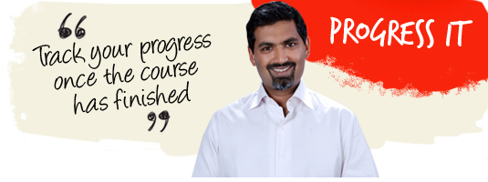
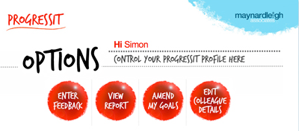
ProgressIT: Online goal tracking
ProgressIt ® is a powerful on-line support system that provides follow through after a course, a workshop or learning event. We use this innovative service to:
Help participants reach their self selected behavioural goals
Show line managers what their colleagues have learned and report on the business results from their new learning
Enable Human Resources departments to offer evidence of specific business gains stemming from a particular learning experience.
Assign supporters to these participants who will give feedback for a period of nine weeks.
ProgressIt ® tackles these with a nine-week support service and a report at the end summarizing progress.
13

Slide 14

One on One Coaching Call
45 minute call
Understanding from the participants, the challenges and issues faced by them
Review the progress on the goals entered in the system and the way forward
This call will allow the coach & the leader to delve deeper into the area of development and as the sessions progress they will be better suited to practise the learning and revisit what worked & what could be better .
14

Slide 15
Implementation Day
Objectives | Session | Session details | Methodology
Getting acquainted with the facilitator | Warm up and introduction | Welcome and context setting Maynardleigh & participant Introductions | Theatrical warm ups Experiential Context setting
Sharing learnings from the last workshop | Revisiting learnings | What you remember from “Impact and influence” workshop. Participants share what worked for them and celebrate. Best Practice Sharing | Participant presentation
What are the challenges faced while applying the learnings | Exploring challenges | Participants share their current challenges while creating an impact and influencing their stakeholders with examples. They write it down and put it in a fish bowl. | Participant led
Understanding how the scenes play out in a real scenario | Role plays | Facilitator takes out one of the scenarios, reads it out to the entire batch and asks for volunteers to come and enact that scenario. (Facilitator can choose to disclose/or not disclose whose scenario is it, taking a buy in from the batch). | Play & Pause –audience is interacting/giving suggestions.
A tool to make your pitch impactful | SPIN Model Introduction | Get to know the situation, problem, implication and need to provide the Solution. Having consultative approach. | Participants presentation
Understanding how the scenes play out in a real scenario. | Role Plays continued… | Facilitator picks up some more scenarios one by one from the fish bowl. | Psycho Drama Role Plays Interactive Theatre
How do we create an impact on the phone | Sharing a tool | Participants learn a tool on how to make impact on the phone | Facilitator led
Understanding how the scenes play out in a real scenario. | Role plays continued…. | Facilitator picks up some more scenarios one by one from the fish bowl. | Two Chair Technique It is a psychodrama technique of being in the other person’s shoe and looking at the situation from a different perspective.
15

Slide 16
Implementation Day
Objectives | Session | Session details | Methodology
Q & A round. Sharing of tools with the participants where they face challenges | Q & A | Participants ask questions to the facilitator | Facilitator led discussion and practice
 | Final Presentations | Participants prepare a pitch - using SPINS ( Situation, Problem, Implication, Need and Solution) OR PPSAAO ( Push, Pull, Support, Anticipate, Answer and Offer). | Facilitator led presentation. Participant exercises.
Closure | Action Planning | Participants fill the stop start and continue sheet

Slide 17

Discovery meeting
A one to one meeting with leader and L&D partner to review the journey and devise the next intervention for the same audience.
16

Slide 18

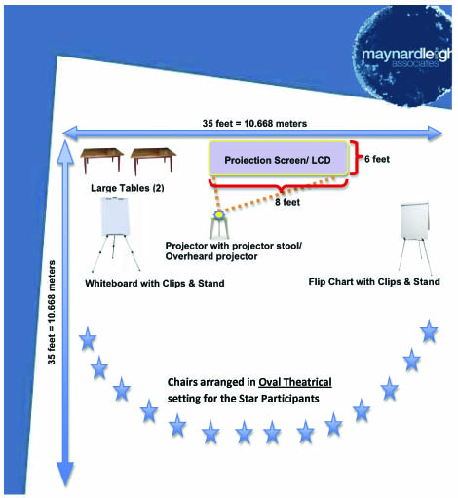
Ambience
We love alternative ways of setting up a workshop! Creating an atmosphere where the participants feels absolutely comfortable and yet challenged. In this workshop, the use of theatre, team games and experiential methodologies are essential ingredients, hence we’d require ample place to move around and make noise.
Please book a space with ample natural light (Yes, we want sunlight streaming in) and no fixed furniture for the 12 leaders to work with one MaynardLeigh consultant.
17

Slide 19
Your Investment for the intervention
Diagnose & Design (For the whole Intervention)
One day Diagnostic Interviews Design ( creating report, customizing design, presentation of design)- I day worth of investment | INR 65,000 (One time charge) INR 65,000 (One time charge)
Delivery (for each batch of 7 participants)
Activity | Investment
Professional Fee for delivery – JUICE Workshop | INR 65,000 Per Day per consultant X 2 Day X 1 consultant | INR 1,30,000/-
Learning Material, Folders, Books, use of Props | INR 630 X 7 (Charged on actuals) | INR 4,410/-
ProgressIT: online goal tracking system | INR 300 X 7 | INR 2,100/-
45 minute coaching call | INR 5,000 X 7 | INR 35,000/-
Implementation day | INR 65,000 per day per consultant X 1 day X 1 consultant | INR 65,000/-
Total Investment for journey covering 7 leaders |  | INR 3,66,510/-
Total investment per leader |  | INR 52,358/-
18

Slide 20
Commercial Terms & Conditions
Client is responsible for providing venue, conference facilities, AV equipment.
Travel outside Delhi NCR – A 15% booking charge would be charged for Air, stay & airport/ venue cab transfers, if booked through MaynardLeigh Travel Desk.
Travel inside Delhi NCR - at Rs. 12.00 Per Km.
Not inclusive of applicable taxes (service tax @ 15.00%).
A commercial contract will be signed before the execution of the project.
50% of cancellation fee will be charged on any cancellation or postponements that occur within 20 working days of the confirmed date of delivery.
The above commercials are valid till the 31st March, 2017
Contracts, legal & accounting paperwork (including billing & payments) will be in the name of “Life Strategies Humancare Pvt. Ltd.”
19

Slide 21
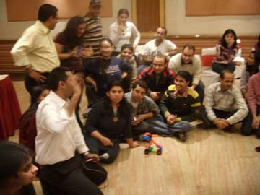
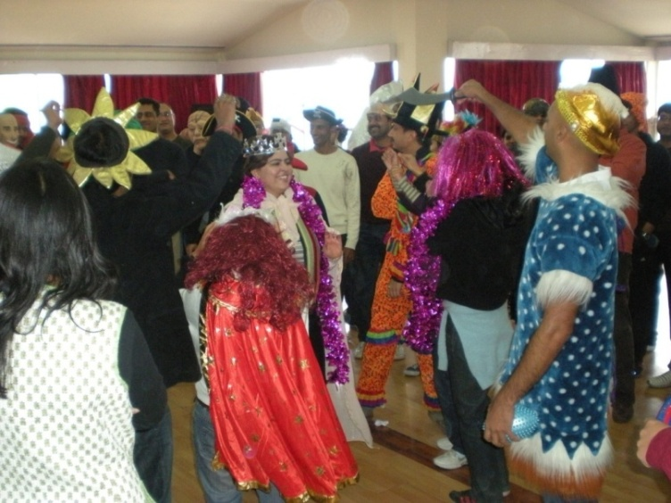
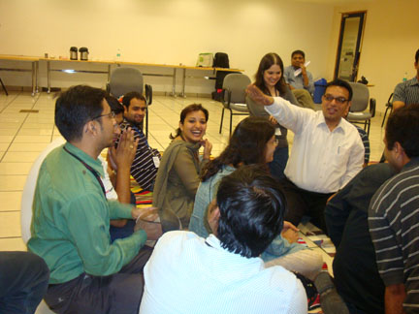
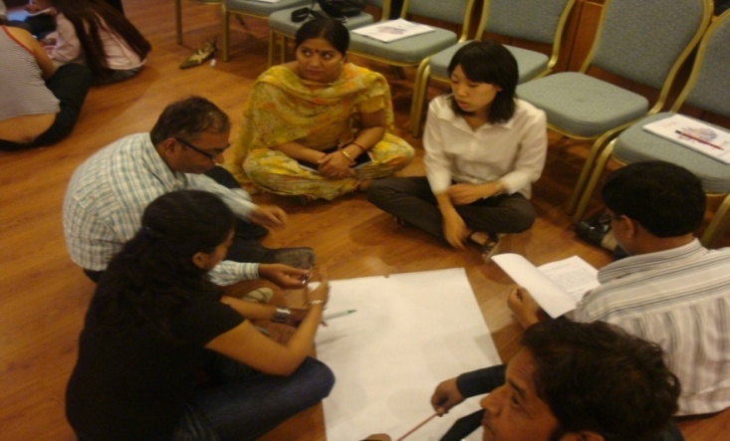

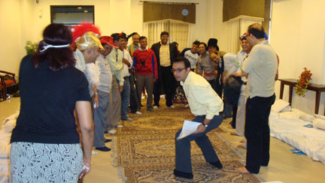
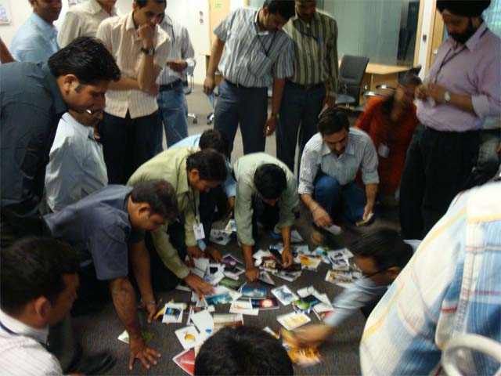
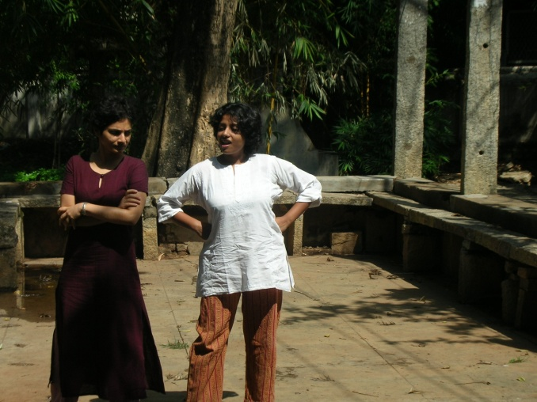
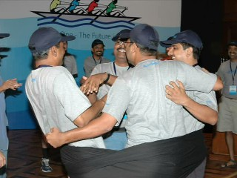
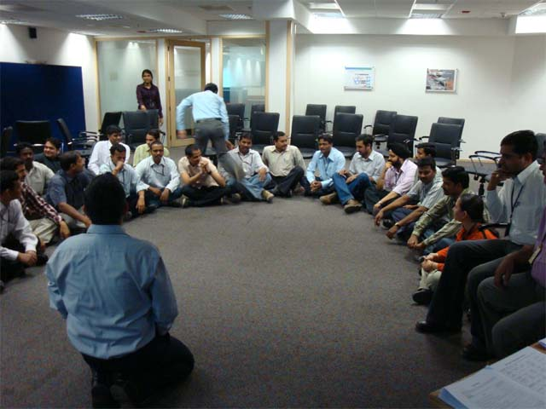
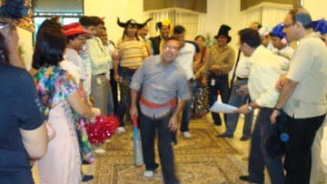

Slide 22

































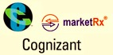





















Our Clients
Notes:
22

Slide 23

Let’s work in partnership to create impact & unlock potential
For further information please connect with:
Contact Jigyasa Sharma/ Varun Gupta
Email jigyasa@maynardleigh.in / varun@maynardleigh.in
Telephone +91 9717922445/ +91 9560192443

